Slide 1
EEL 5934
Trajectory tracking sliding mode control of underactuated AUV
Kai wei Cheng ouyang

Slide 2
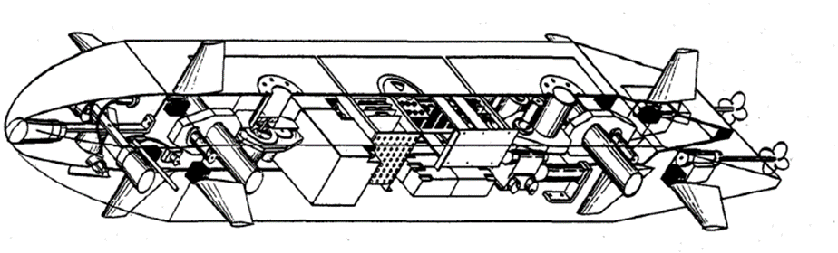
Background
Autonomous underwater vehicles (AUVs) play a major role in the exploration of oceans, and in scientific and military missions. These vehicles are required to execute different types of missions without the interaction of human operators while performing well under a variety of load conditions and with unknown sea currents.
Motion control of AUVs may have different control objectives such as trajectory tracking, path following and way-point tracking. The trajectory tracking refers to the design of control laws so that the vehicle tracks a desired, time-parametrized trajectory, while the path following requires the path to be independent of time and is expressed in terms of its geometric description

Slide 3
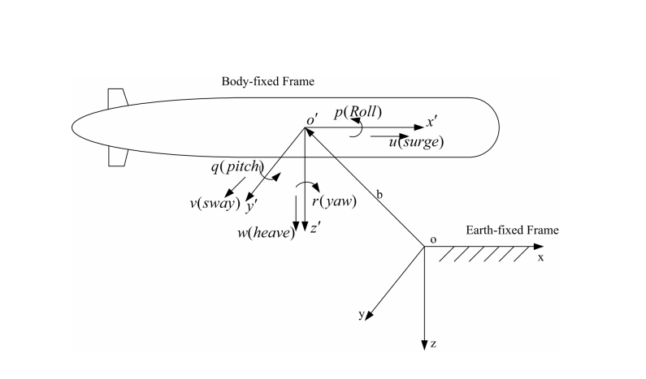
What we do
Designing a nonlinear motion controller for an autonomous underwater vehicle to track an arbitrary trajectory. The trajectory is assumed to be smooth and bounded.
The stability of the tracking system should proved and validated through simulations. The controller should be tuned to achieve good performance and reasonable settling times.

Slide 4
Related works & Refferences
Challenge
Encountered the sliding mode surface oscillation problem. We replaced the discontinuous function sign with the continuous function tanh, thus eliminating the problem of oscillation .
[1] Elmokadem, Taha, Mohamed Zribi, and Kamal Youcef-Toumi. "Trajectory tracking sliding mode control of underactuated AUVs."

Slide 5
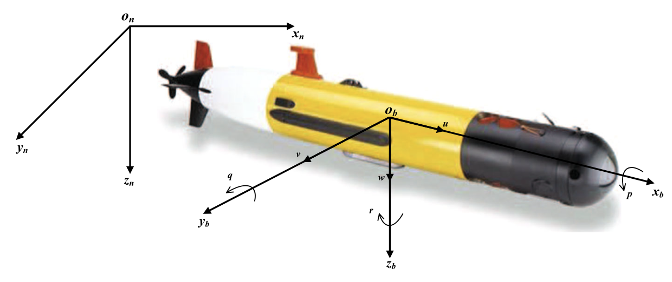
6 degrees of freedom
the surge (longitudinal motion)
the sway (lateral motion)
the yaw (rotation about the vertical axis)
heave (vertical motion)
the roll (rotational motion about the longitudinal axis)
the pitch (rotational motion about the lateral axis)

Slide 6
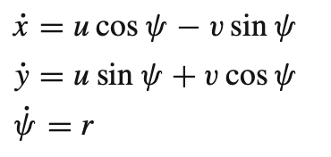
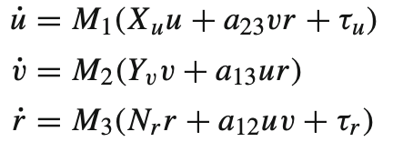
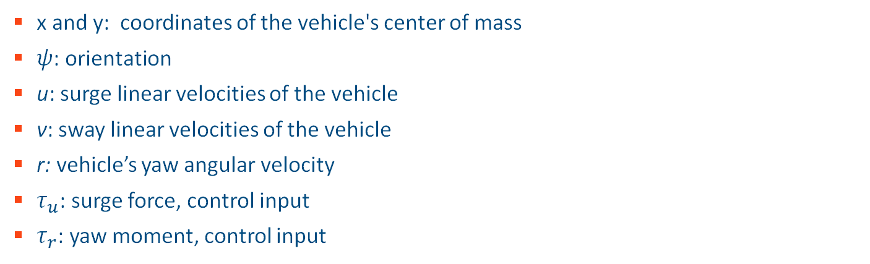
Kinematic equations
x and y: coordinates of the vehicle's center of mass
$ψ$: orientation
u: surge linear velocities of the vehicle
v: sway linear velocities of the vehicle
r: vehicle’s yaw angular velocity
$τ_{u}$: surge force, control input
$τ_{r}$: yaw moment, control input

Slide 7
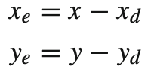
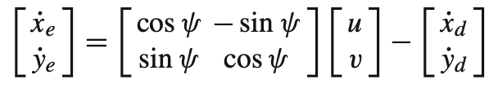
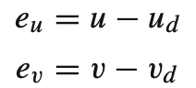
Define tracking errors
Position tracking errors:
Velocity tracking errors:
We want to let x – xd = 0, y– yd = 0, this means that the auv moves along the trajectory we want

Slide 8
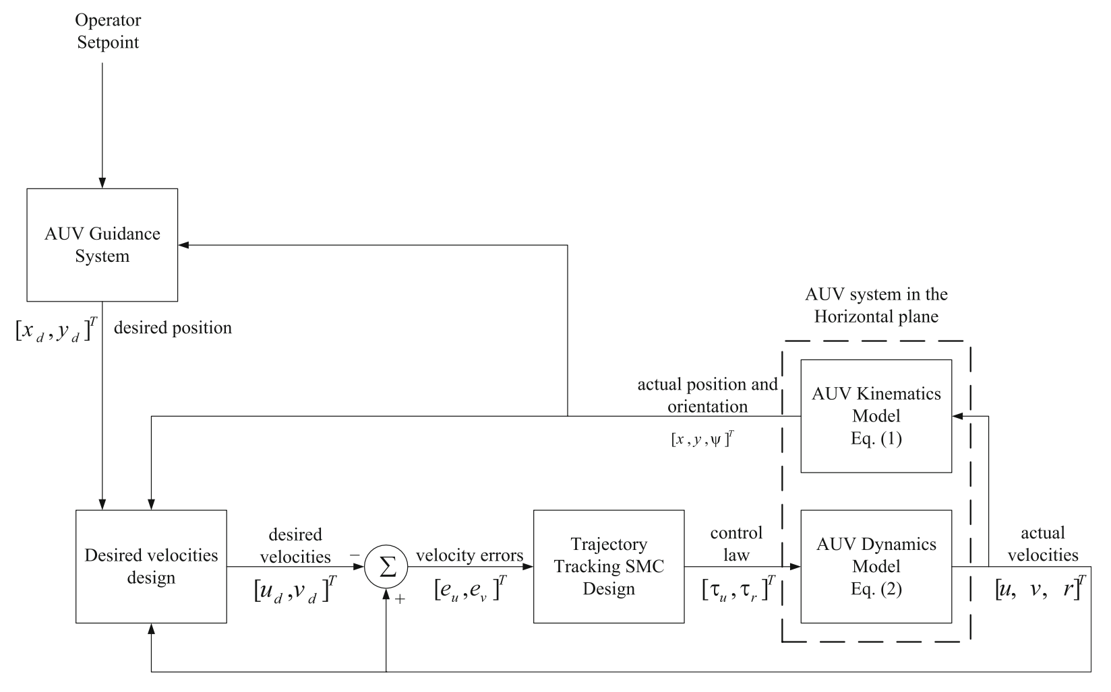
A block diagram of the AUV’s trajectory tracking control system

Slide 9
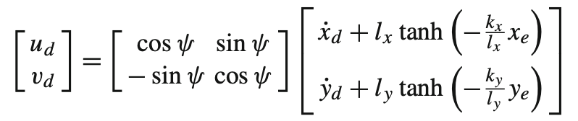
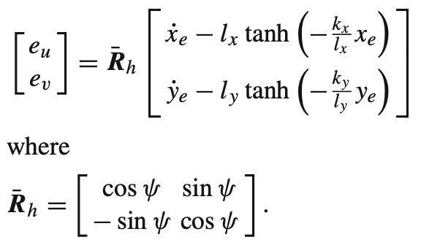
Desired velocities design
Let the desired surge and sway velocities be such that,
Then, we can get the following:

Slide 10
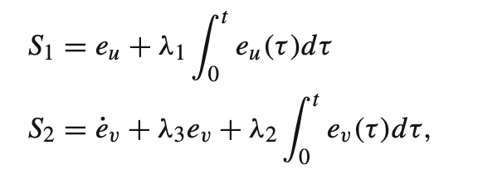
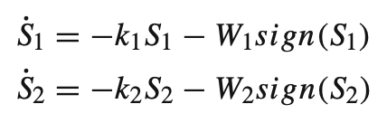
Trajectory tracking SMC design
We will choose the sliding surfaces such that:
We will choose the reaching law such that:

Slide 11
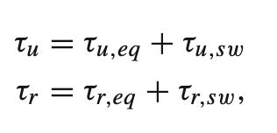
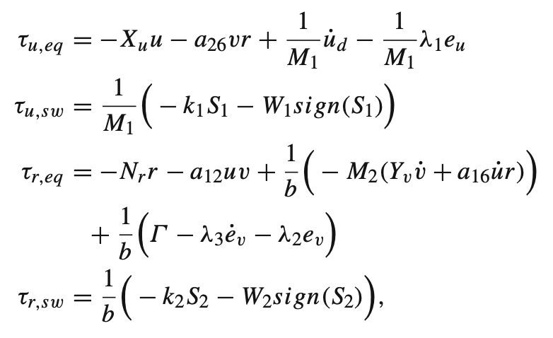
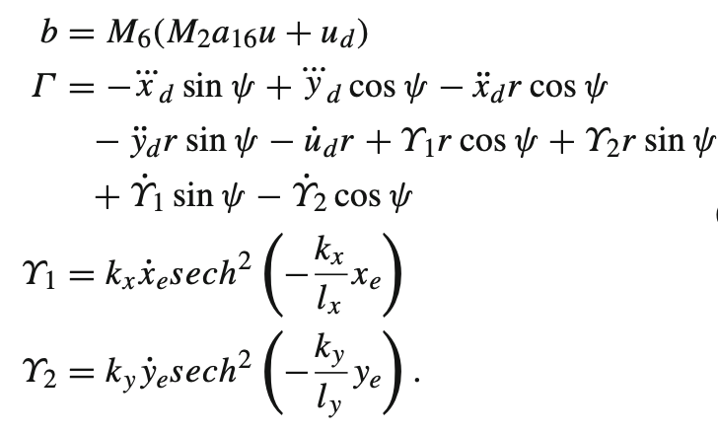
the trajectory tracking surge and yaw control laws are chosen such that:
where,

Slide 12
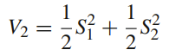
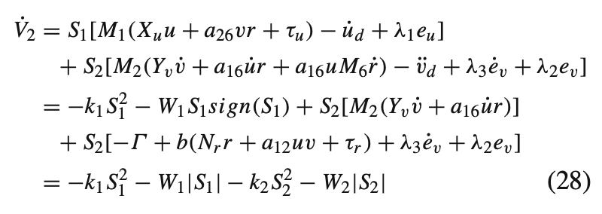

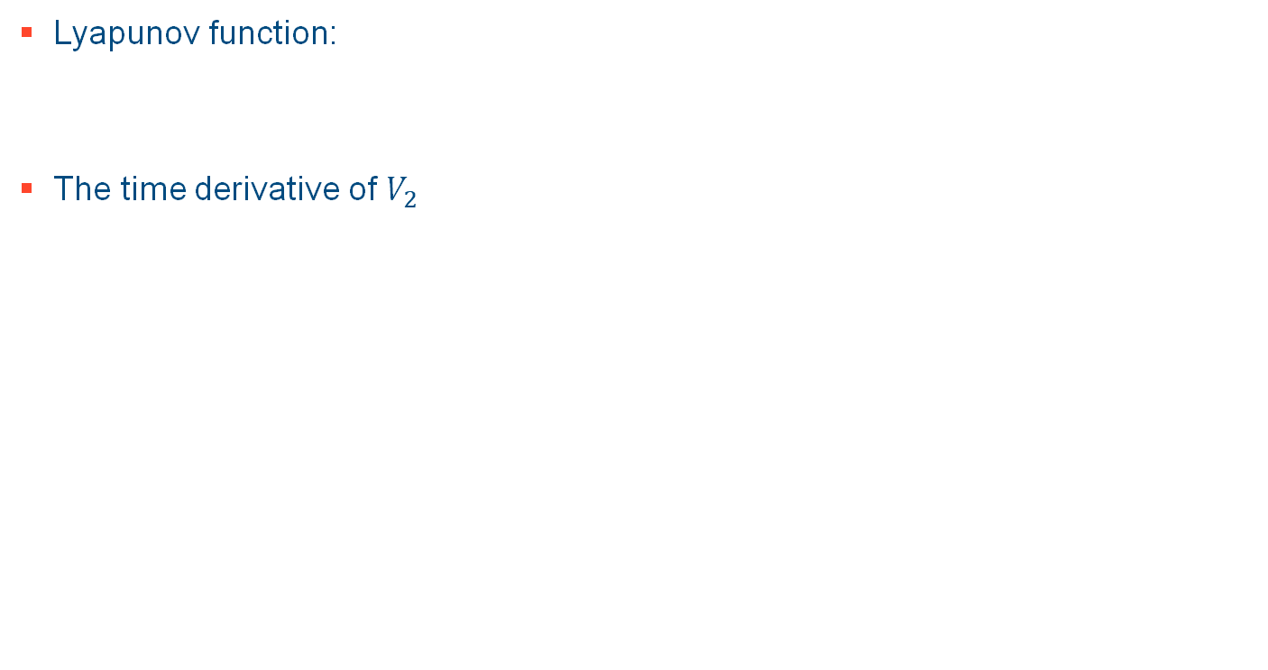
Lyapunov-Based Stability Analysis
Lyapunov function:
The time derivative of $V_{2}$

Slide 13
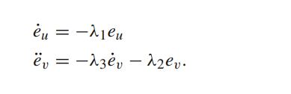
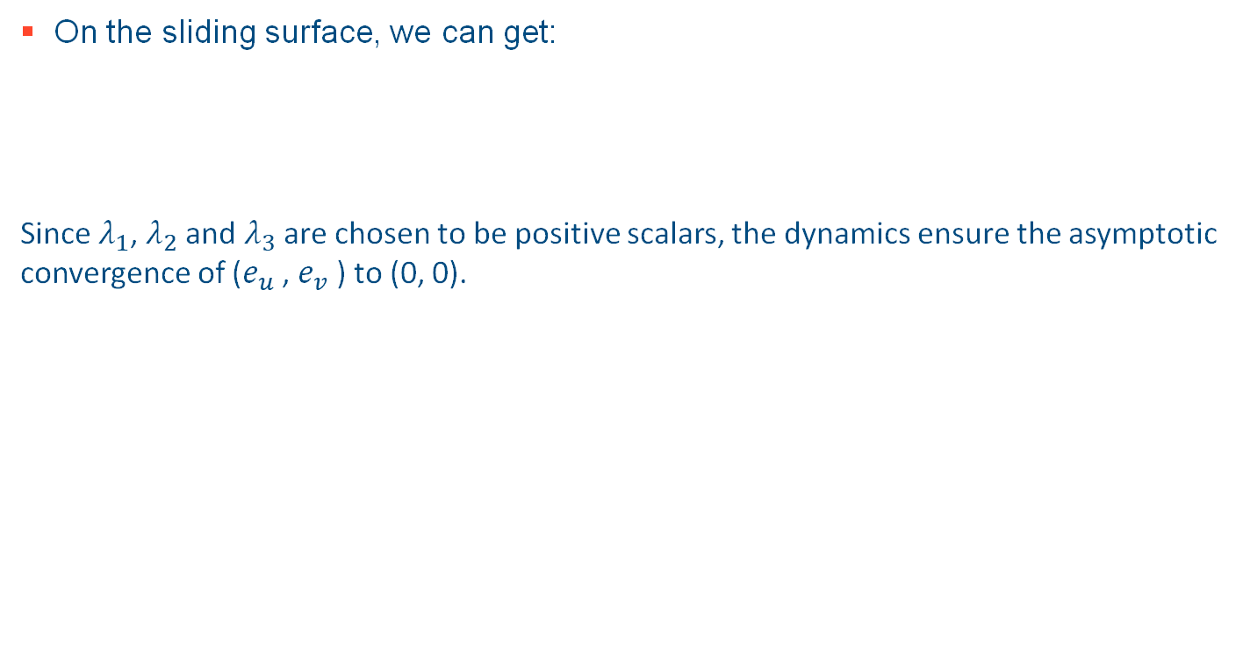
On the sliding surface, we can get:
Since $λ_{1}$, $λ_{2}$ and $λ_{3}$ are chosen to be positive scalars, the dynamics ensure the asymptotic convergence of ($e_{u}$ , $e_{v}$ ) to (0, 0).

Slide 14
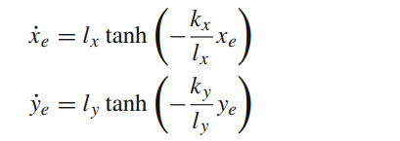
According to this function:
We can get

Slide 15
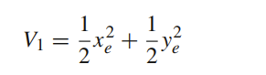
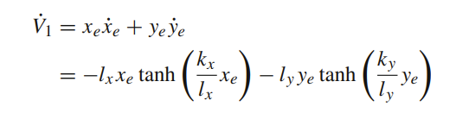
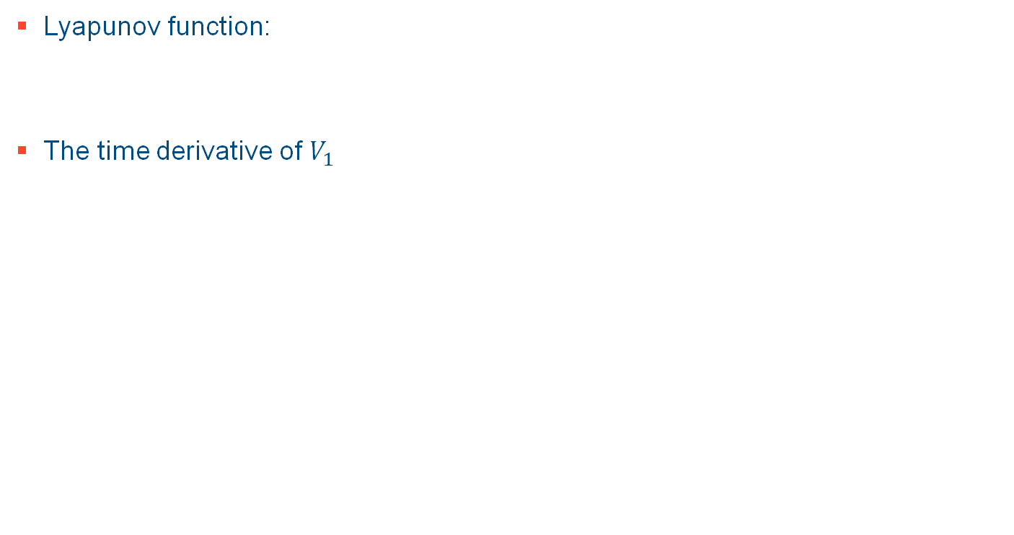
Lyapunov function:
The time derivative of $V_{1}$

Slide 16
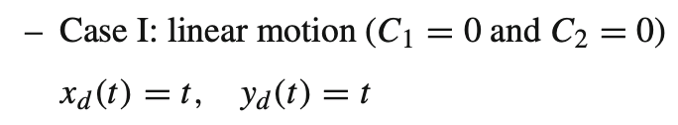
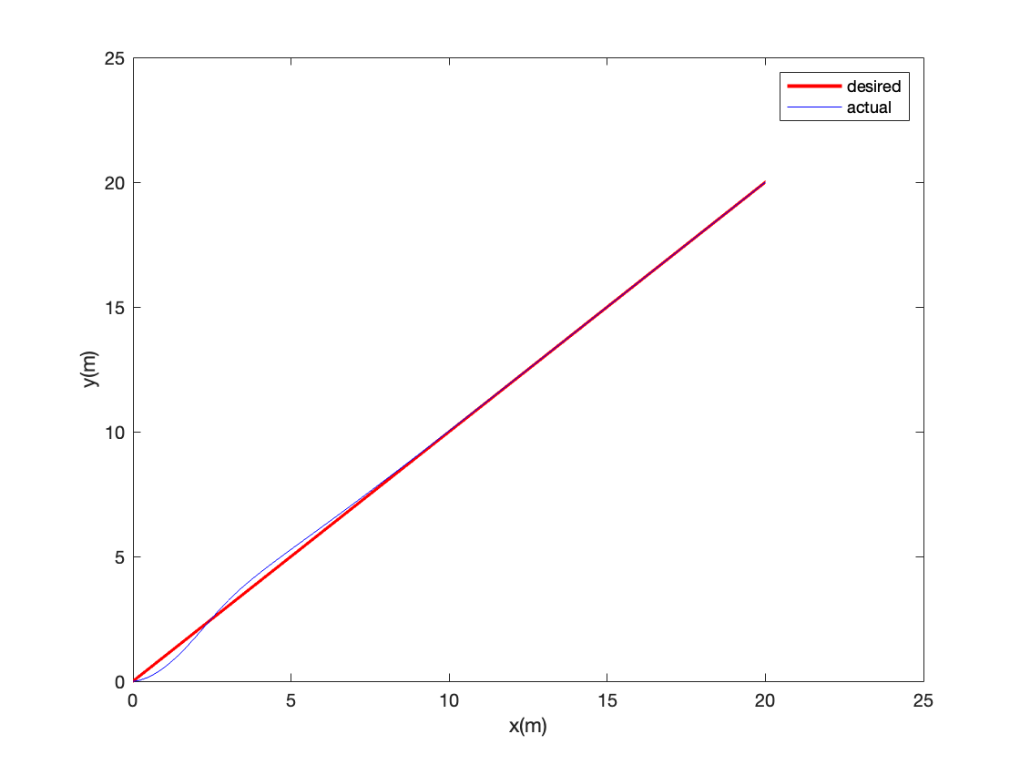
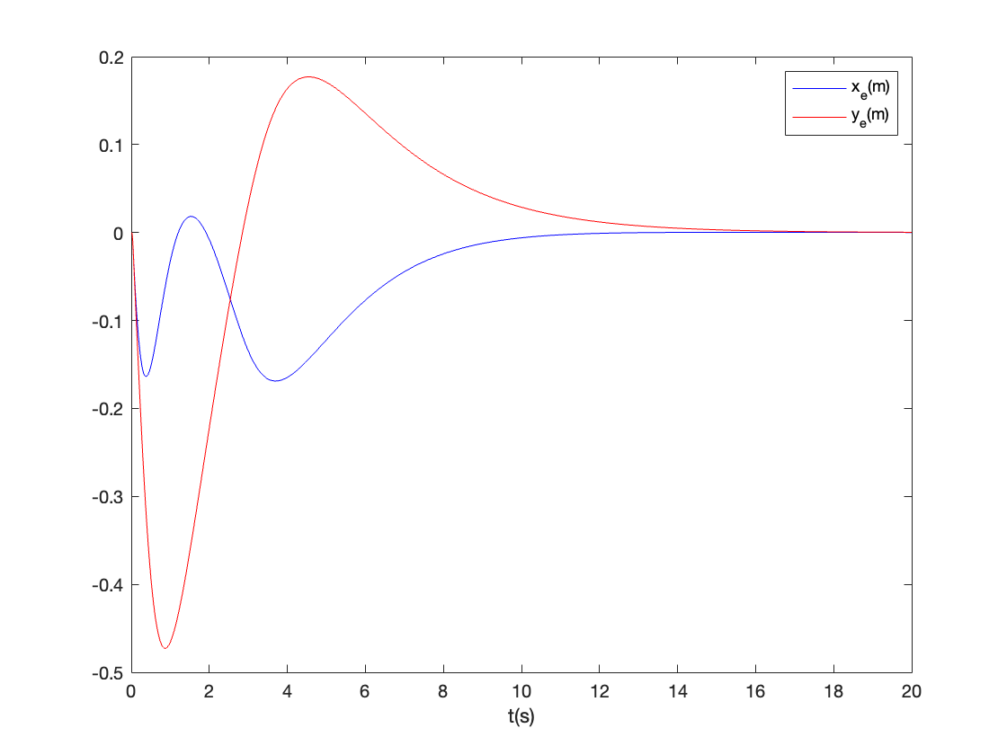
Simulation result
Fig1. The actual and desired paths of the AUV
Fig2. The position tracking errors of the AUV

Slide 17
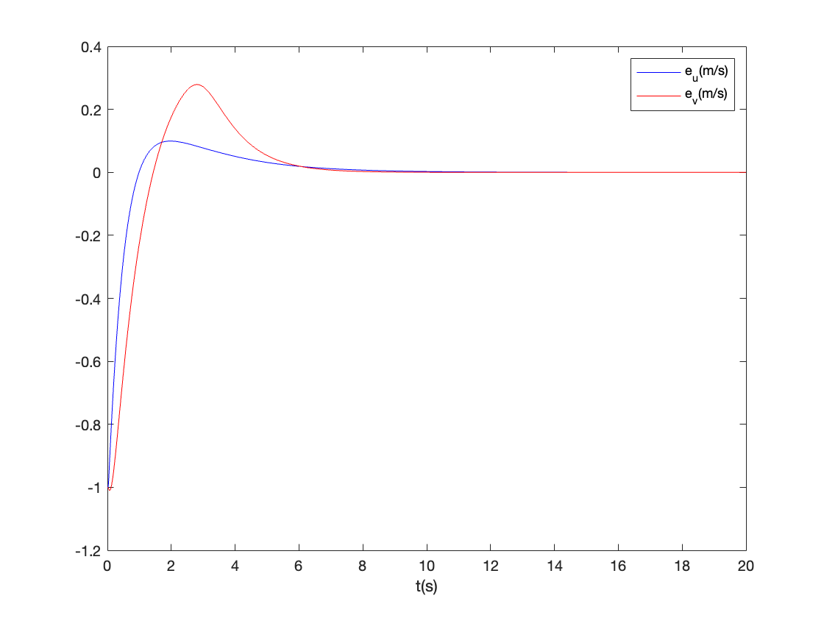
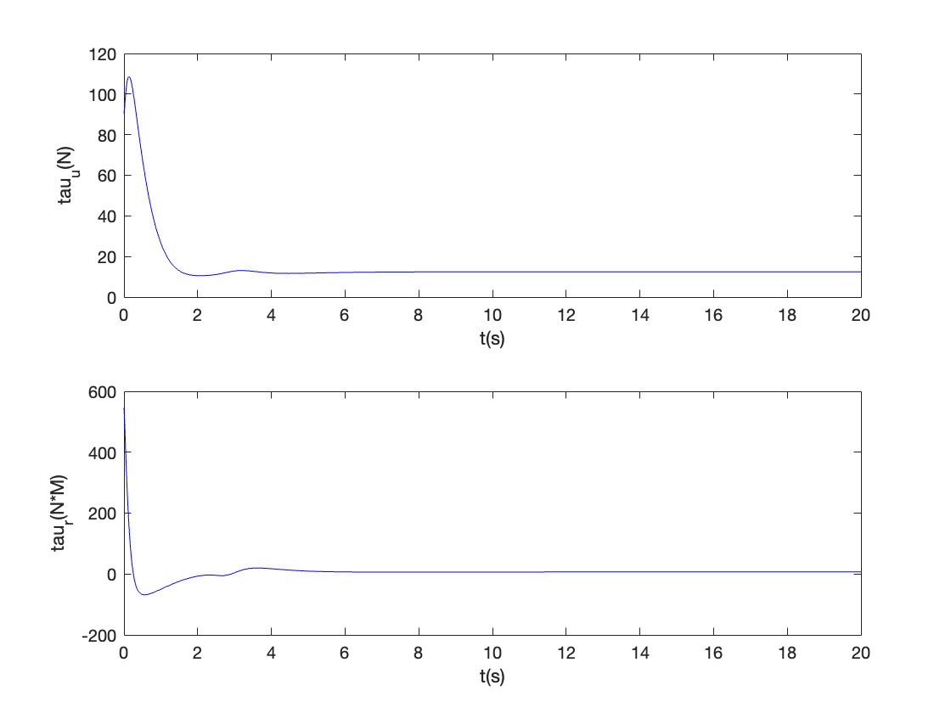
Fig3. The velocity tracking errors of the AUV
Fig4. The surge and yaw control laws of the AUV

Slide 18
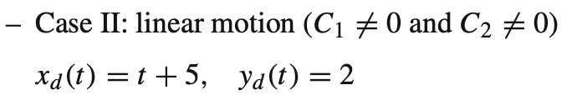
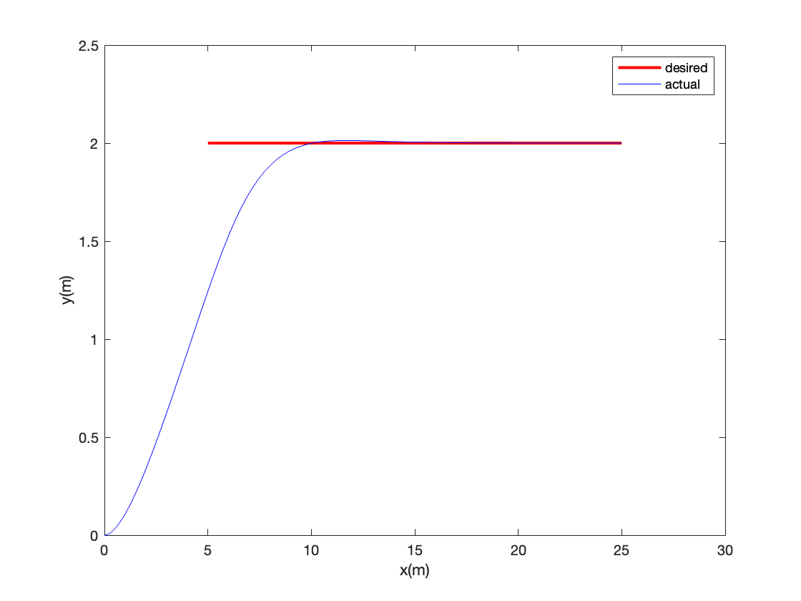
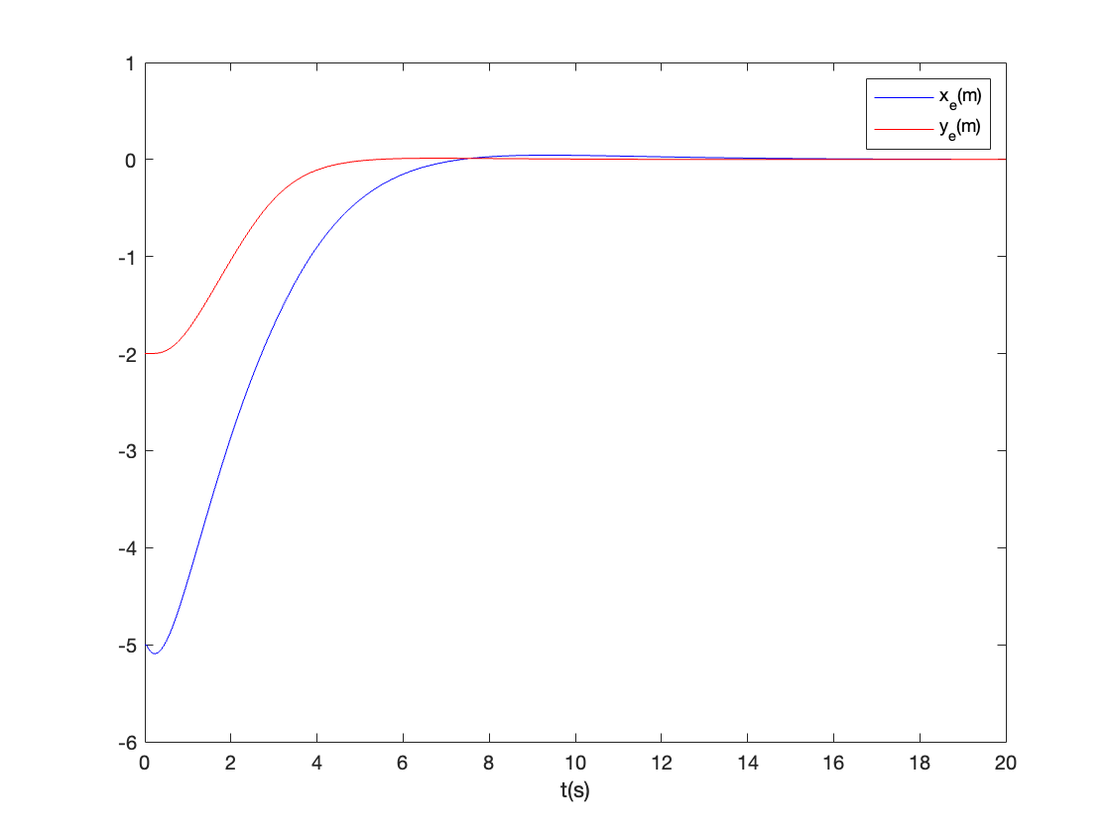
Fig5. The actual and desired paths of the AUV
Fig6. The position tracking errors of the AUV

Slide 19
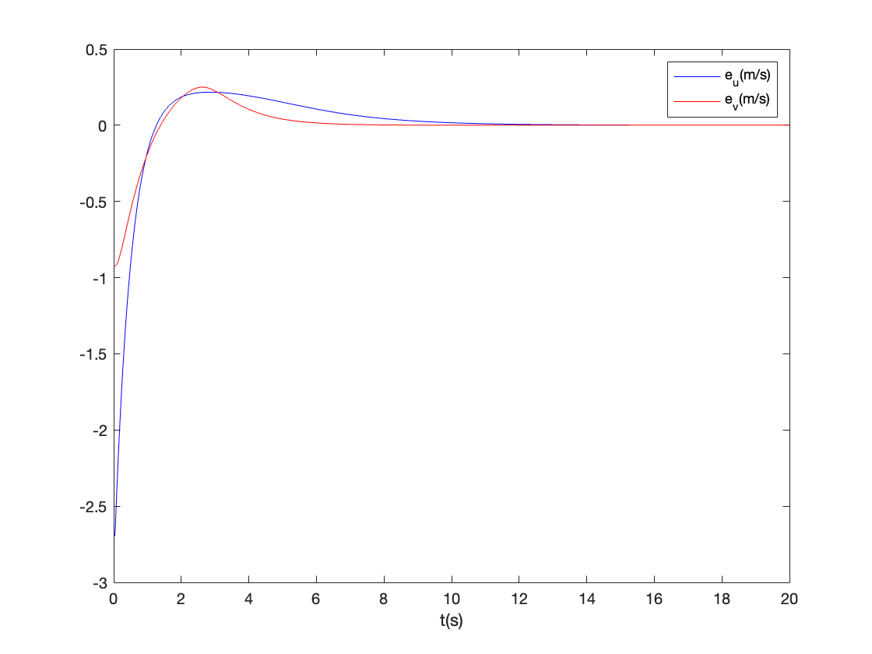
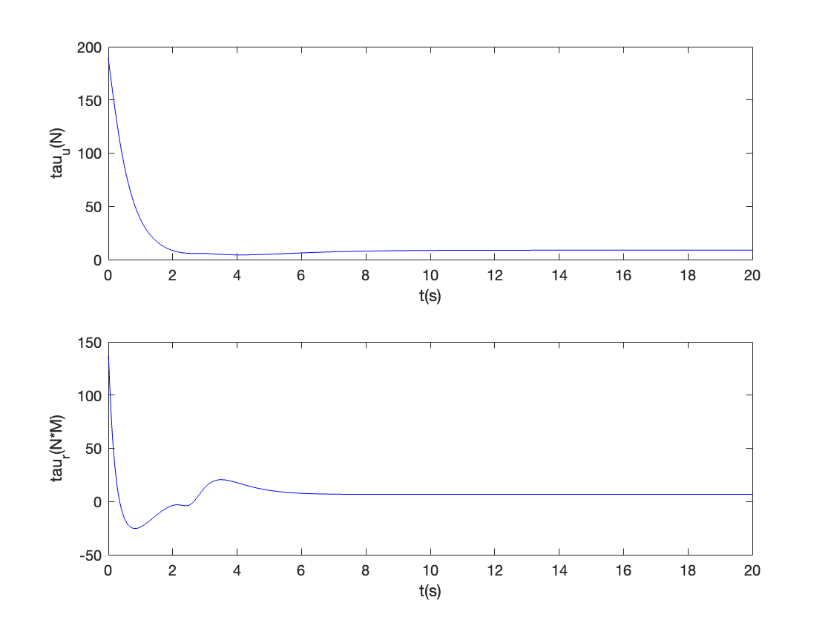
Fig7. The velocity tracking errors of the AUV
Fig8. The surge and yaw control laws of the AUV

Slide 20
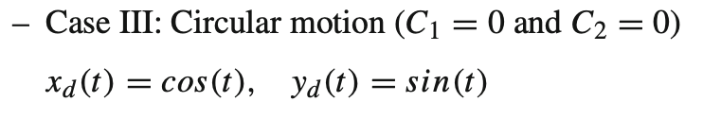
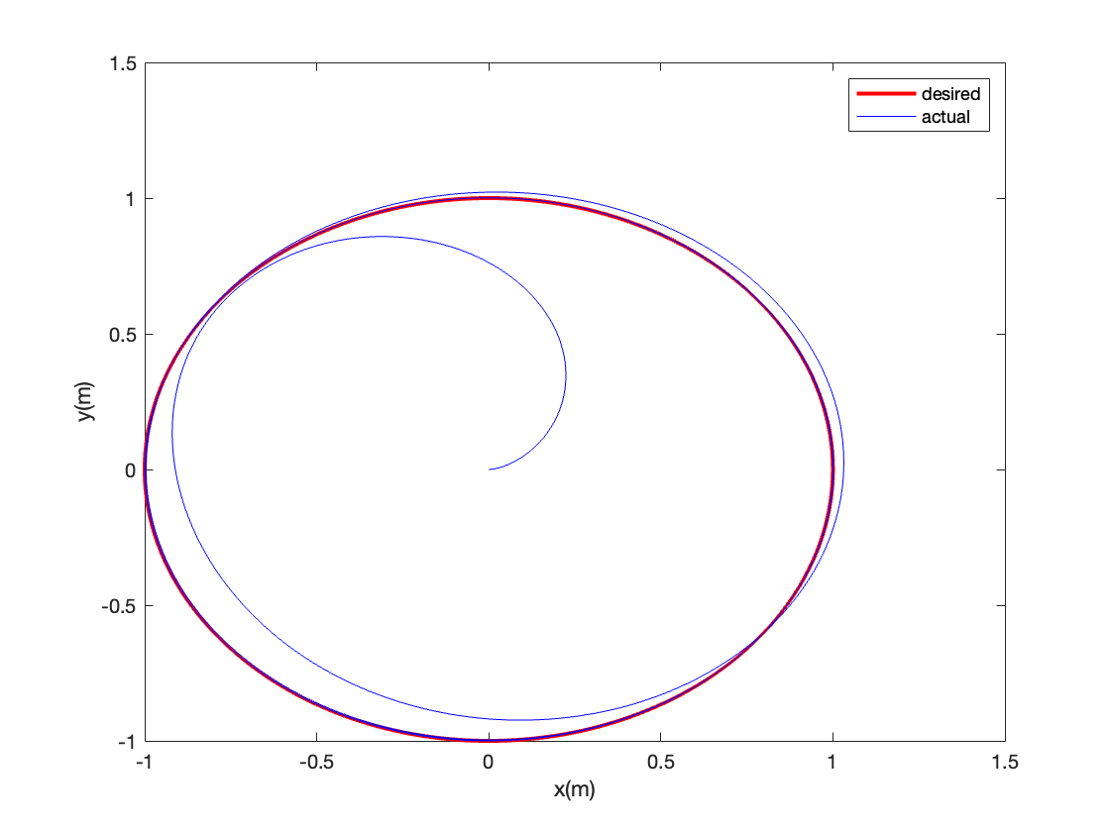
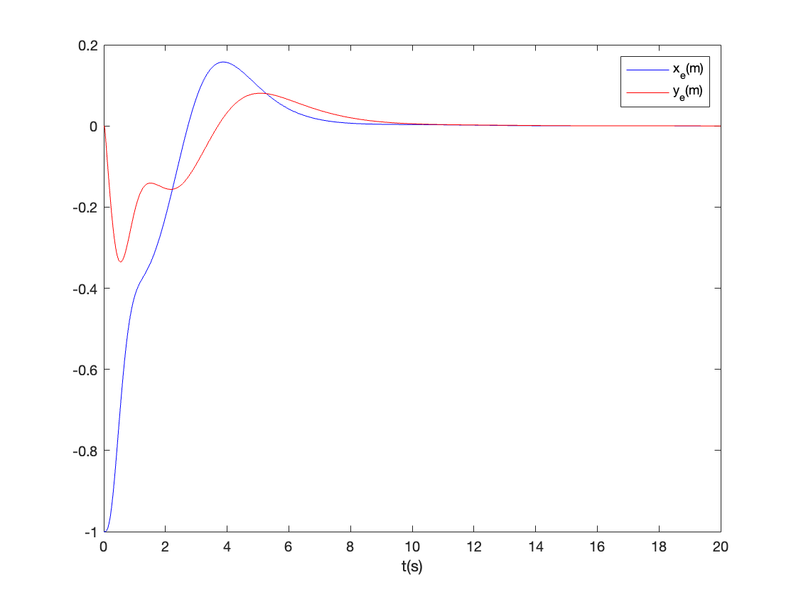
Fig9. The actual and desired paths of the AUV
Fig10. The position tracking errors of the AUV

Slide 21
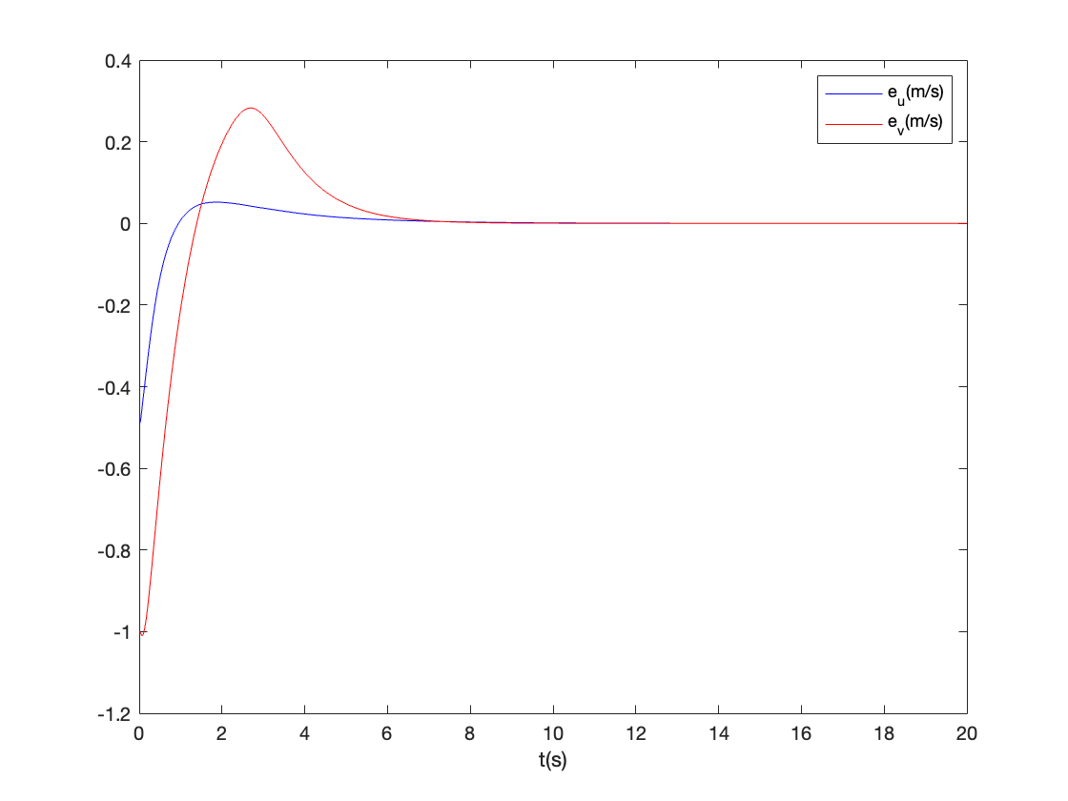
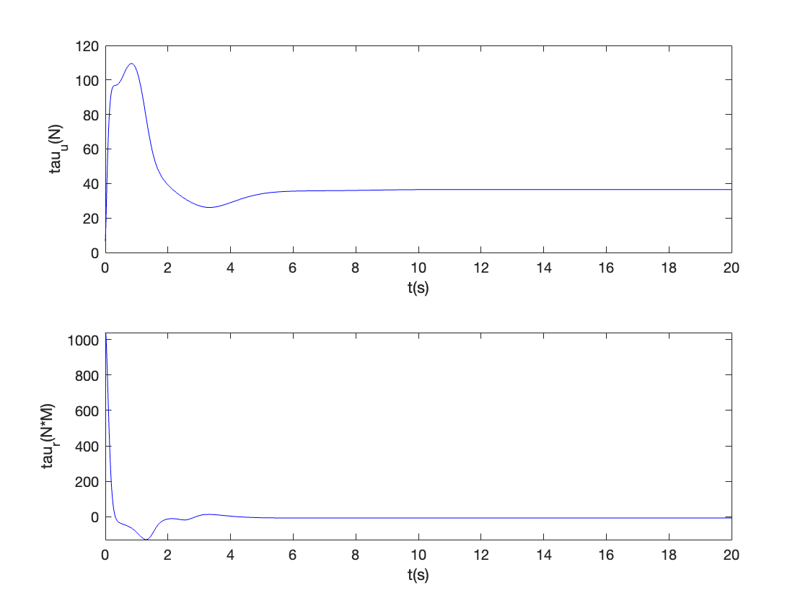
Fig11. The velocity tracking errors of the AUV
Fig12. The surge and yaw control laws of the AUV

Slide 22
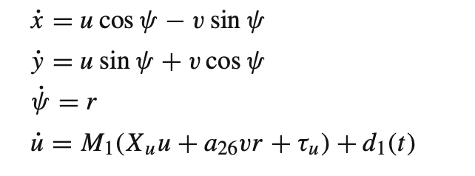
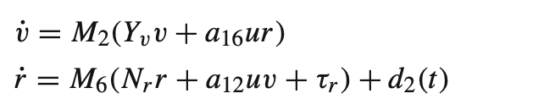
Robustness Studies
The new AUV kinematic and dynamic equations are,

Slide 23
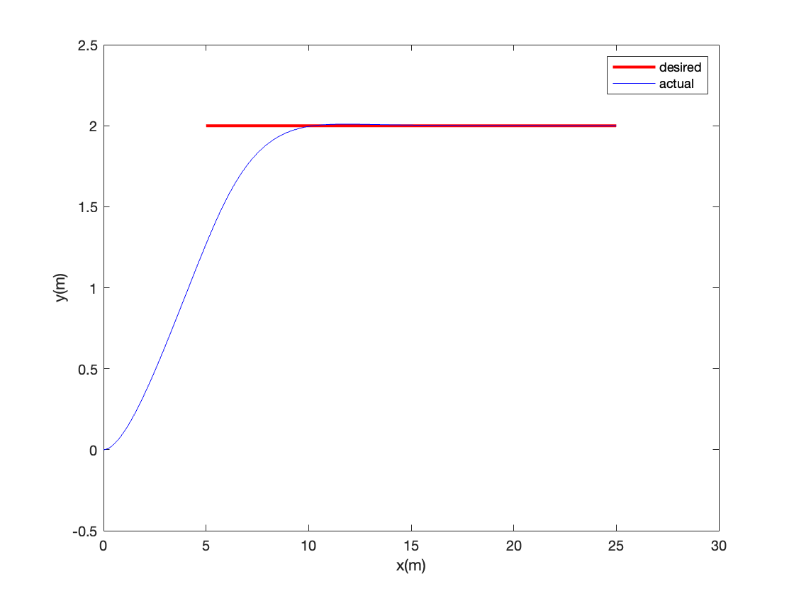
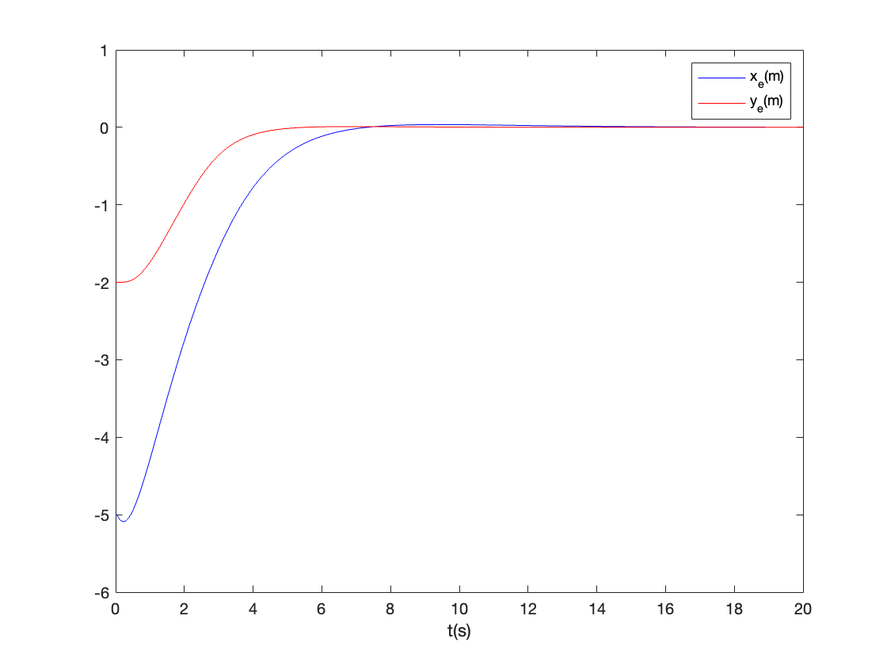

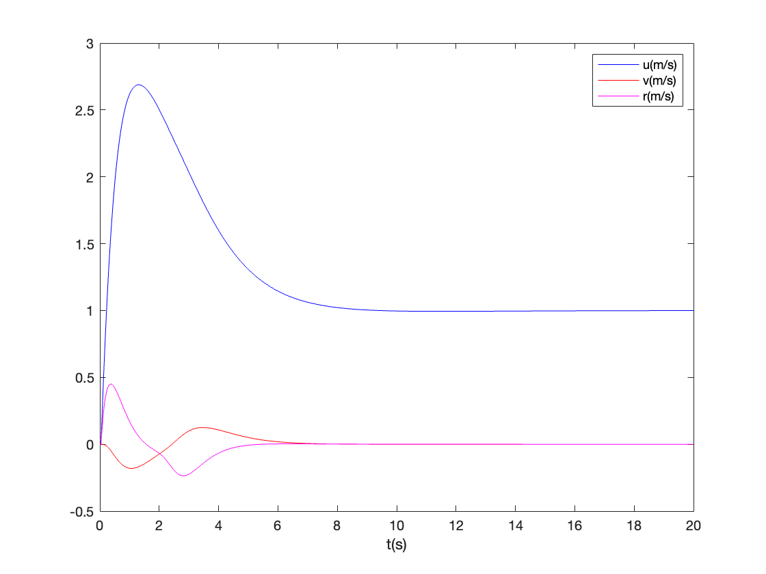
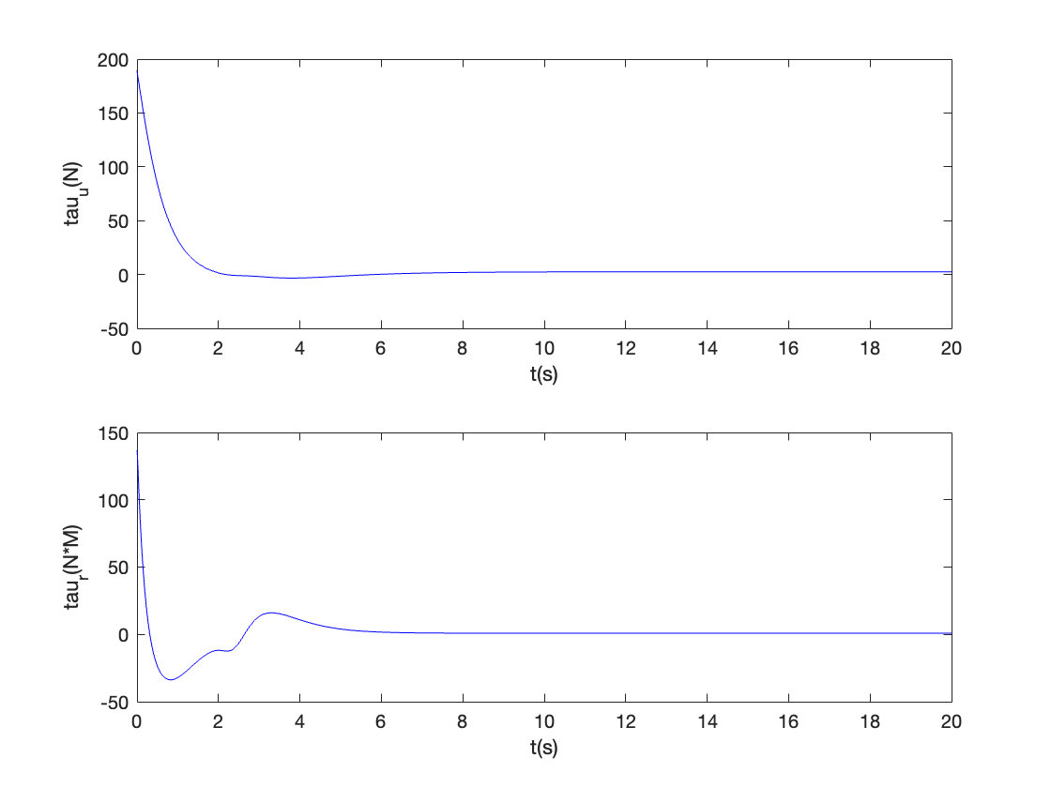
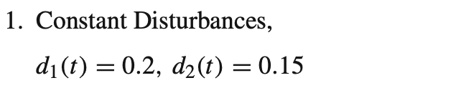

Slide 24

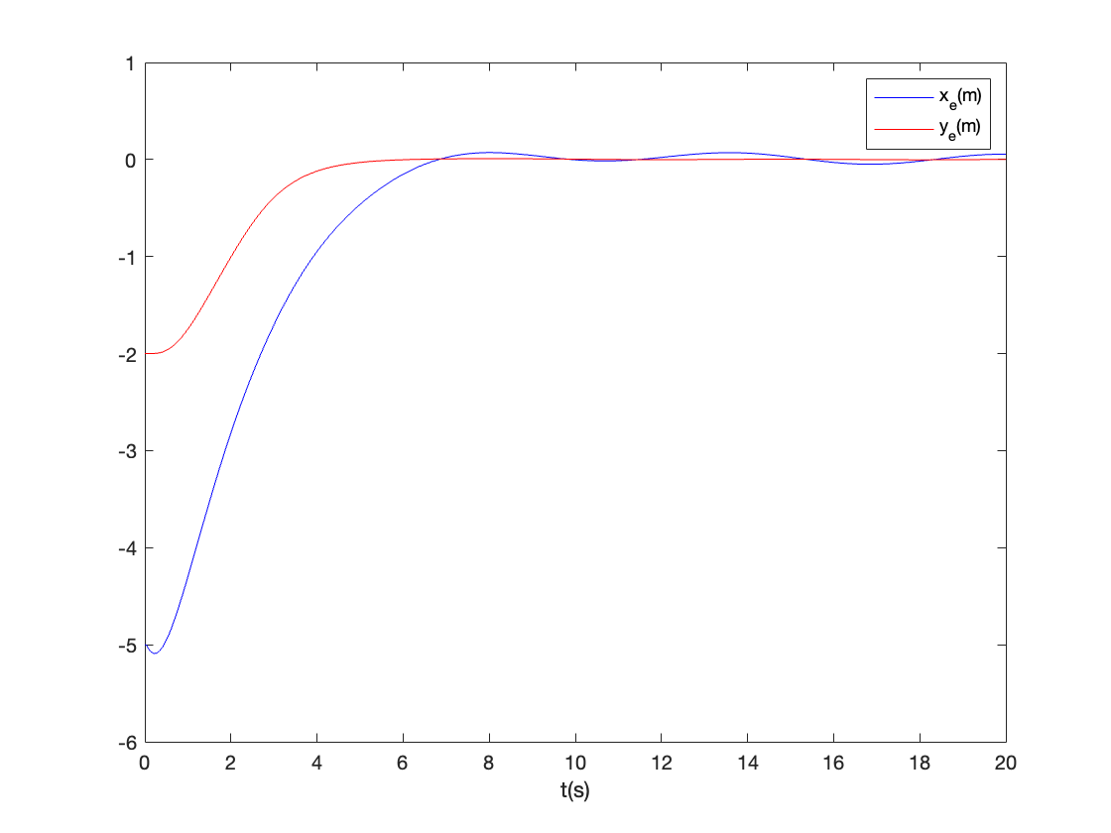
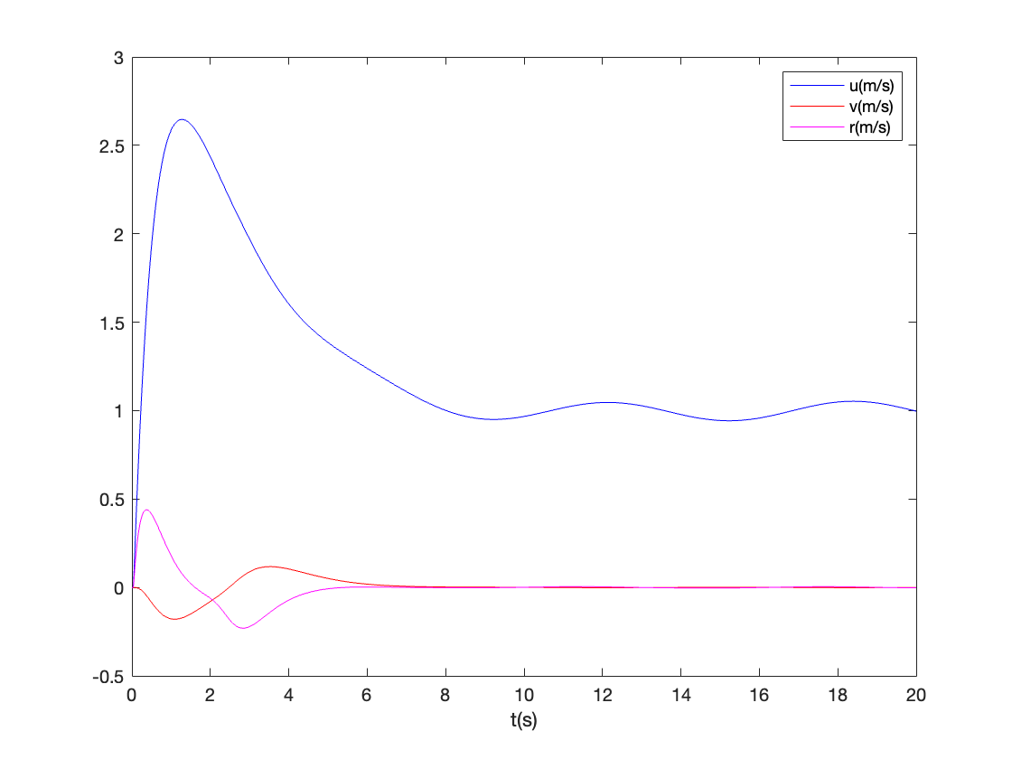




Slide 25
Conclusion
A trajectory tracking sliding mode control scheme is proposed for the control of the lateral motion of AUVs.
The objective of this controller is to force the position of the AUV to track a desired, time-varying trajectory.
The control design is validated by applying it to an AUV and simulating its performance for different cases of reference trajectories.
the proposed control scheme works well for the three different cases.
the proposed control scheme is robust to bounded disturbances.

Slide 26

Thanks!

